Slide 1
Radial Basis Function Networks
Computer Science,
KAIST
236875 Visual Recognition

Slide 2
contents
Introduction
Architecture
Designing
Learning strategies
MLP vs RBFN
236875 Visual Recognition

Slide 3
introduction
Completely different approach by viewing the design of a neural network as a curve-fitting (approximation) problem in high-dimensional space ( I.e MLP )
236875 Visual Recognition

Slide 4
In MLP
introduction
236875 Visual Recognition

Slide 5
In RBFN
introduction
236875 Visual Recognition

Slide 6
Radial Basis Function Network
introduction
A kind of supervised neural networks
Design of NN as curve-fitting problem
Learning
  find surface in multidimensional space best fit to training data
Generalization
  Use of this multidimensional surface to interpolate the test data
236875 Visual Recognition

Slide 7
Radial Basis Function Network
introduction
Approximate function with linear combination of Radial basis functions
F(x) = Σ w_{i} h(x)
h(x) is mostly Gaussian function
236875 Visual Recognition

Slide 8
architecture
x₁
h₁
W₁
h₂
x₂
W₂
h₃
x₃
W₃
f(x)
W_{m}
x_{n}
h_{m}
Input layer
236875 Visual Recognition
Hidden layer
Output layer

Slide 9
Three layers
architecture
Input layer
  Source nodes that connect to the network to its environment
Hidden layer
  Hidden units provide a set of basis function
  High dimensionality
Output layer
  Linear combination of hidden functions
236875 Visual Recognition

Slide 10
Radial basis function
architecture
m
f(x) = ∑ w_{j}h_{j}(x)
j=1
h_{j}(x) = exp( -(x-c_{j})² / r_{j}² )
Where c_{j} is center of a region,
r_{j} is width of the receptive field
236875 Visual Recognition

Slide 11
designing
Require
  Selection of the radial basis function width parameter
  Number of radial basis neurons
236875 Visual Recognition

Slide 12
Selection of the RBF width para.
designing
Not required for an MLP
smaller width
  alerting in untrained test data
Larger width
  network of smaller size & faster execution
236875 Visual Recognition

Slide 13
Number of radial basis neurons
designing
By designer
Max of neurons = number of input
Min of neurons = ( experimentally determined)
More neurons
  More complex, but smaller tolerance
236875 Visual Recognition

Slide 14
learning strategies
Two levels of Learning
  Center and spread learning (or determination)
  Output layer Weights Learning
Make # ( parameters) small as possible
  Curse of Dimensionality
236875 Visual Recognition

Slide 15
Various learning strategies
learning strategies
how the centers of the radial-basis functions of the network are specified.
Fixed centers selected at random
Self-organized selection of centers
Supervised selection of centers
236875 Visual Recognition

Slide 16
Fixed centers selected at random(1)
learning strategies
Fixed RBFs of the hidden units
The locations of the centers may be chosen randomly from the training data set.
We can use different values of centers and widths for each radial basis function -> experimentation with training data is needed.
236875 Visual Recognition

Slide 17
Fixed centers selected at random(2)
learning strategies
Only output layer weight is need to be learned.
Obtain the value of the output layer weight by pseudo-inverse method
Main problem
  Require a large training set for a satisfactory level of performance
236875 Visual Recognition

Slide 18
Self-organized selection of centers(1)
learning strategies
Hybrid learning
  self-organized learning to estimate the centers of RBFs in hidden layer
  supervised learning to estimate the linear weights of the output layer
Self-organized learning of centers by means of clustering.
Supervised learning of output weights by LMS algorithm.
236875 Visual Recognition

Slide 19
Self-organized selection of centers(2)
learning strategies
k-means clustering
  Initialization
  Sampling
  Similarity matching
  Updating
  Continuation
236875 Visual Recognition

Slide 20
Supervised selection of centers
learning strategies
All free parameters of the network are changed by supervised learning process.
Error-correction learning using LMS algorithm.
236875 Visual Recognition

Slide 21
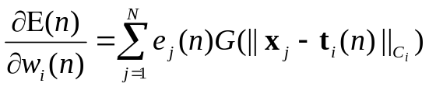
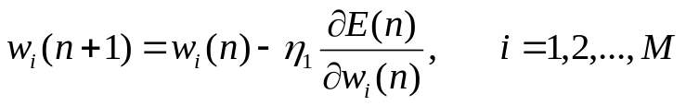
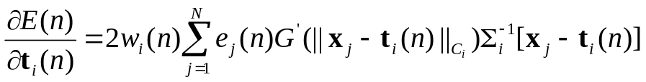
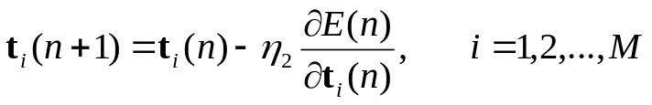
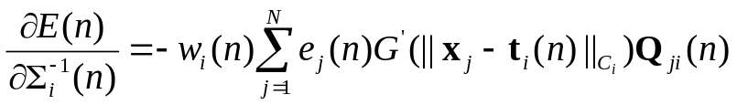

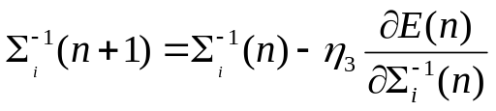
Learning formula
learning strategies
Linear weights (output layer)
Positions of centers (hidden layer)
Spreads of centers (hidden layer)
236875 Visual Recognition

Slide 22
MLP vs RBFN
Global hyperplane | Local receptive field
EBP | LMS
Local minima | Serious local minima
Smaller number of hidden neurons | Larger number of hidden neurons
Shorter computation time | Longer computation time
Longer learning time | Shorter learning time
236875 Visual Recognition

Slide 23
Approximation
MLP vs RBFN
MLP : Global network
  All inputs cause an output
RBF : Local network
  Only inputs near a receptive field produce an activation
  Can give “don’t know” output
236875 Visual Recognition

Slide 24
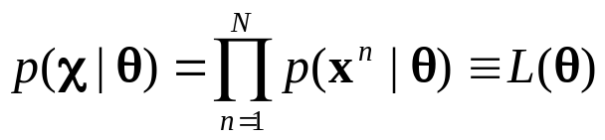
Gaussian Mixture
Given a finite number of data points x^{n}, n=1,…N, draw from an unknown distribution, the probability function p(x) of this distribution can be modeled by
  Parametric methods
    Assuming a known density function (e.g., Gaussian) to start with, then
    Estimate their parameters by maximum likelihood
    For a data set of N vectors χ={x¹,…, x^{N}} drawn independently from the distribution p(x|θ), the joint probability density of the whole data set χ is given by
236875 Visual Recognition

Slide 25
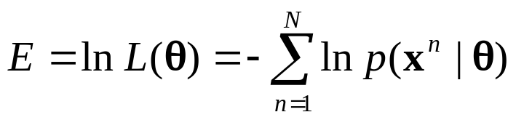
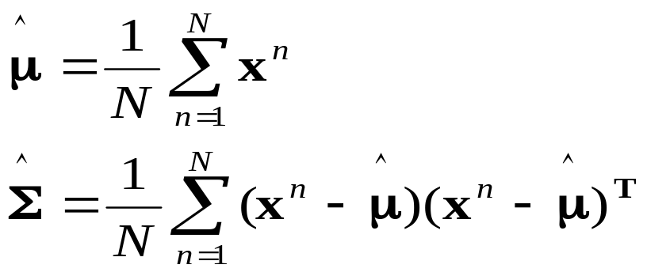
Gaussian Mixture
    L(θ) can be viewed as a function of θ for fixed χ, in other words, it is the likelihood of θ for the given χ
    The technique of maximum likelihood sets the value of θ by maximizing L(θ).
    In practice, often, the negative logarithm of the likelihood is considered, and the minimum of E is found.
    For normal distribution, the estimated parameters can be found by analytic differentiation of E:
236875 Visual Recognition

Slide 26
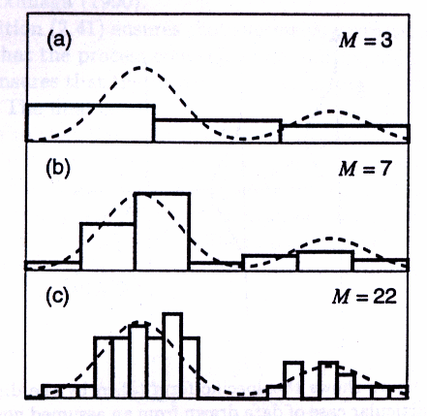
Gaussian Mixture
Non-parametric methods
  Histograms
  An illustration of the histogram approach to density estimation. The set of 30 sample data points are drawn from the sum of two normal distribution, with means 0.3 and 0.8, standard deviations 0.1 and amplitudes 0.7 and 0.3 respectively. The original distribution is shown by the dashed curve, and the histogram estimates are shown by the rectangular bins. The number M of histogram bins within the given interval determines the width of the bins, which in turn controls the smoothness of the estimated density.
236875 Visual Recognition

Slide 27
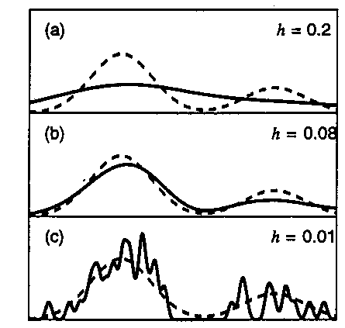
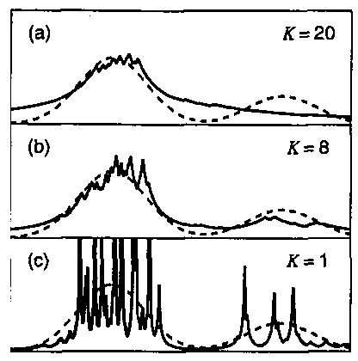
Gaussian Mixture
  Density estimation by basis functions, e.g., Kenel functions, or k-nn
(a) kernel function, (b) K-nn
Examples of kernel and K-nn approaches to density estimation.
236875 Visual Recognition

Slide 28
Gaussian Mixture
Discussions
  Parametric approach assumes a specific form for the density function, which may be different from the true density, but
    The density function can be evaluated rapidly for new input vectors
  Non-parametric methods allows very general forms of density functions, thus the number of variables in the model grows directly with the number of training data points.
    The model can not be rapidly evaluated for new input vectors
  Mixture model is a combine of both: (1) not restricted to specific functional form, and (2) yet the size of the model only grows with the complexity of the problem being solved, not the size of the data set.
236875 Visual Recognition

Slide 29
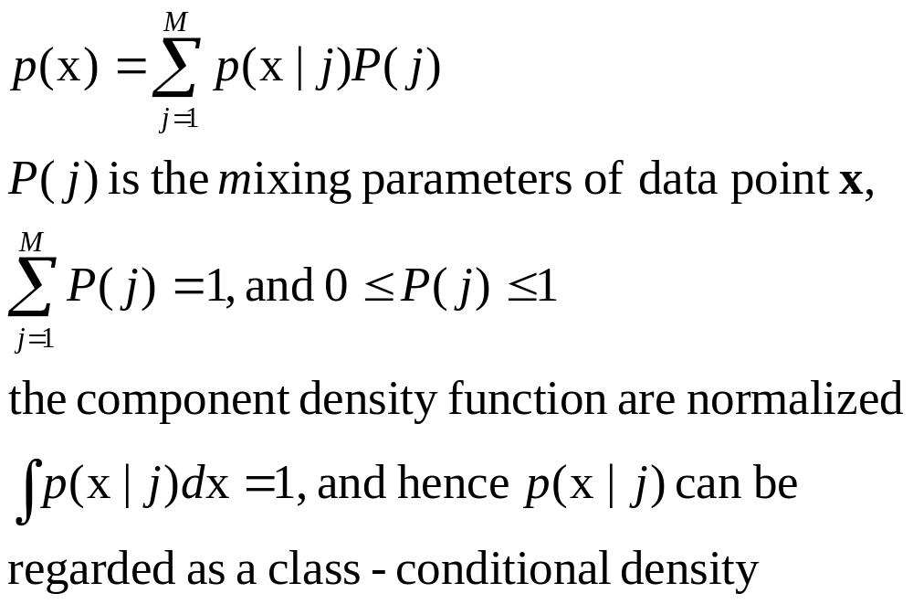
Gaussian Mixture
The mixture model is a linear combination of component densities p(x| j ) in the form
236875 Visual Recognition

Slide 30
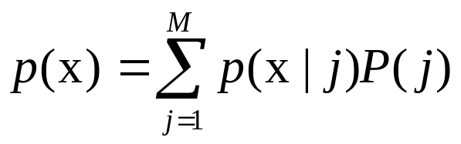
Gaussian Mixture
The key difference between the mixture model representation and a true classification problem lies in the nature of the training data, since in this case we are not provided with any “class labels” to say which component was responsible for generating each data point.
This is so called the representation of “incomplete data”
However, the technique of mixture modeling can be applied separately to each class-conditional density p(x|C_{k}) in a true classification problem.
In this case, each class-conditional density p(x|C_{k}) is represented by an independent mixture model of the form
236875 Visual Recognition

Slide 31
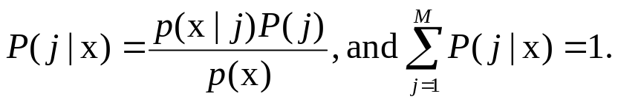
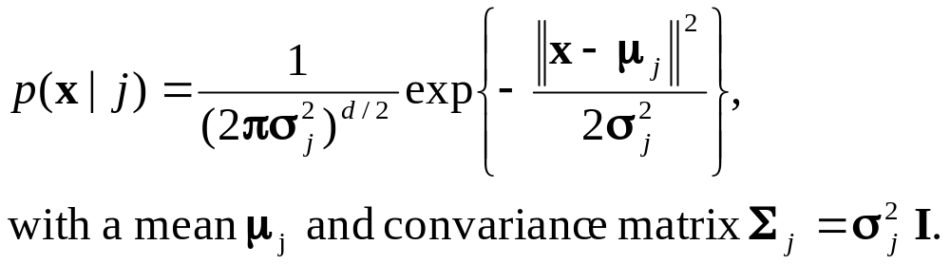
Gaussian Mixture
Analog to conditional densities and using Bayes’ theorem, the posterior Probabilities of the component densities can be derived as
The value of P(j|x) represents the probability that a component j was responsible for generating the data point x.
Limited to the Gaussian distribution, each individual component densities are given by :
Determine the parameters of Gaussian Mixture methods:
(1) maximum likelihood, (2) EM algorithm.
236875 Visual Recognition

Slide 32
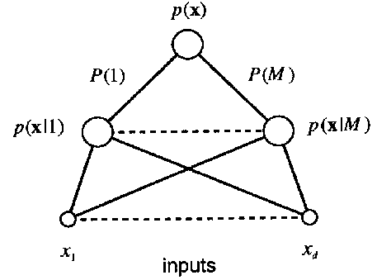
Gaussian Mixture
Representation of the mixture model in terms of a network diagram. For a component densities p(x|j), lines connecting the inputs x_{i} to the component p(x|j) represents the elements μ_{ji} of the corresponding mean vectors μ_{j} of the component j.
236875 Visual Recognition

Slide 33
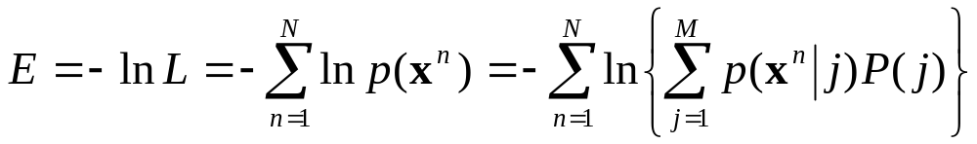
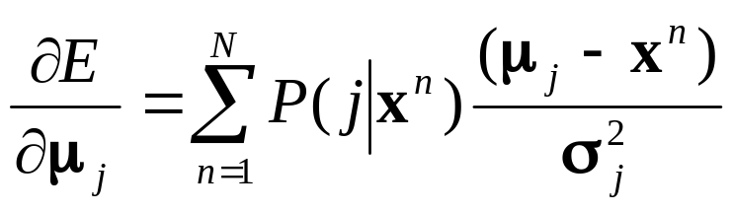
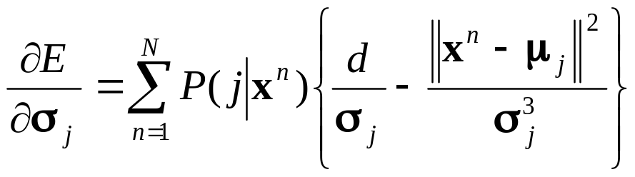
Maximum likelihood
The mixture density contains adjustable parameters: P(j), μ_{j} and σ_{j} where j=1, …,M.
The negative log-likelihood for the data set {x^{n}} is given by:
Maximizing the likelihood is then equivalent to minimizing E
Differentiation E with respect to
  the centres μ_{j} :
  the variances σ_{j :}
236875 Visual Recognition

Slide 34
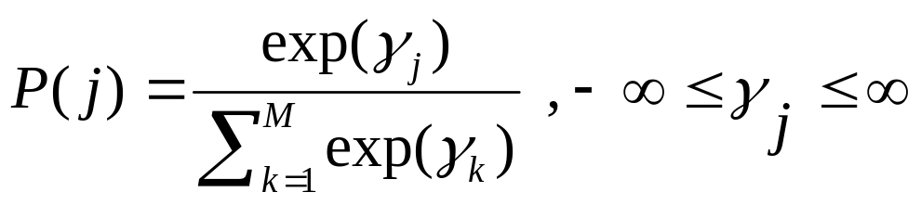
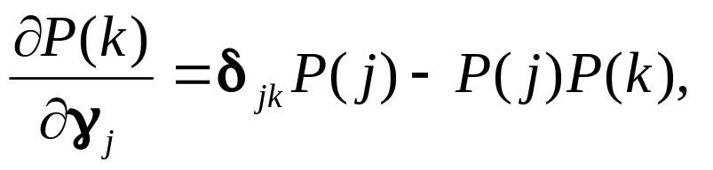
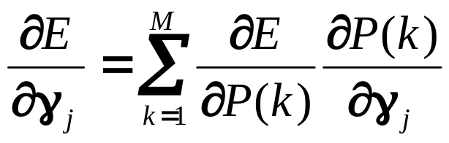
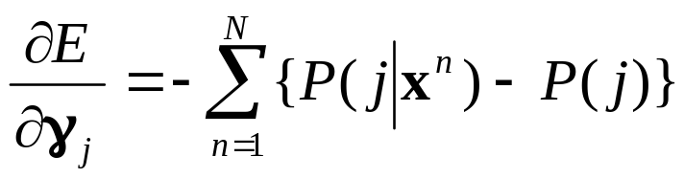
Maximum likelihood
Minimizing of E with respect to to the mixing parameters P(j), must subject to the constraints Σ P(j) =1, and 0< P(j) <1. This can be alleviated by changing P(j) in terms a set of M auxiliary variables {γ_{j}} such that:
The transformation is called the softmax function, and
the minimization of E with respect to γ_{j} is
using chain rule in the form
then,
236875 Visual Recognition

Slide 35
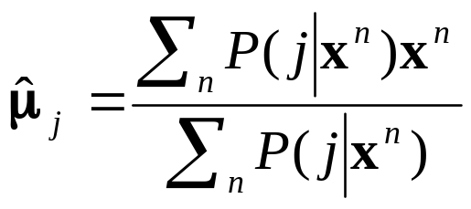
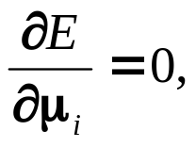
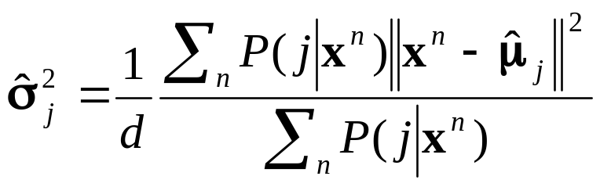
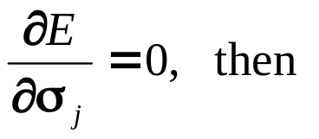
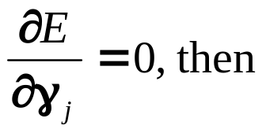
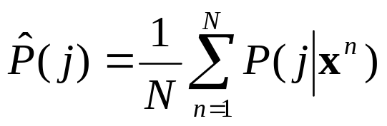
Maximum likelihood
Setting we obtain
Setting
Setting
These formulai give some insight of the maximum likelihood solution, they do not provide a direct method for calculating the parameters, i.e., these formulai are in terms of P(j|x).
They do suggest an iterative scheme for finding the minimal of E
236875 Visual Recognition

Slide 36
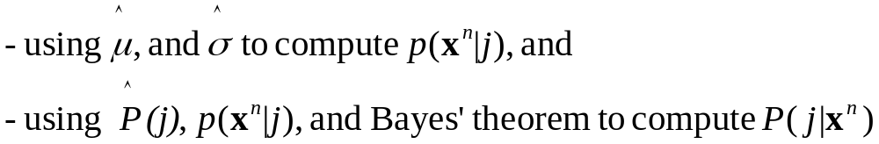
Maximum likelihood
we can make some initial guess for the parameters, and use these formula to compute a revised value of the parameters.
Then, using P(j|x^{n}) to estimate new parameters,
Repeats these processes until converges
236875 Visual Recognition

Slide 37
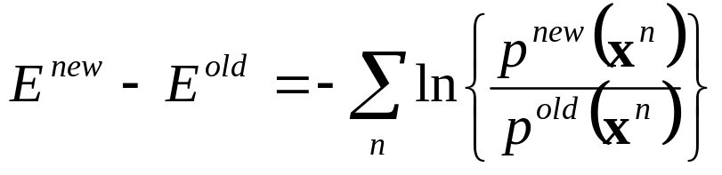
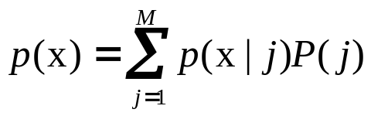
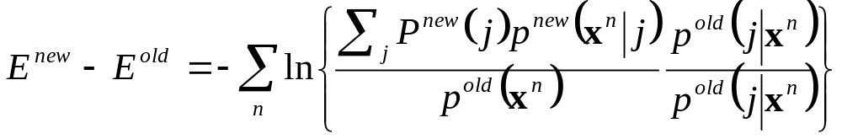
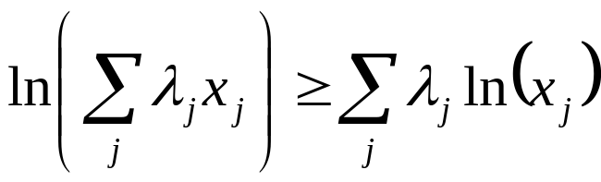
The EM algorithm
The iteration process consists of (1) expectation and (2) maximization steps, thus it is called EM algorithm.
We can write the change in error of E, in terms of old and new parameters by:
Using we can rewrite this as follows
Using Jensen’s inequality: given a set of numbers λj ≥ 0,
such that Σ_{j}λj=1,
236875 Visual Recognition

Slide 38
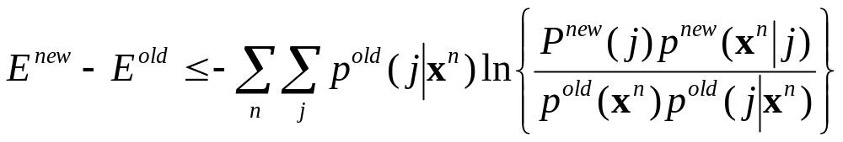
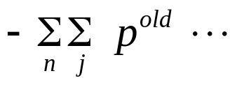


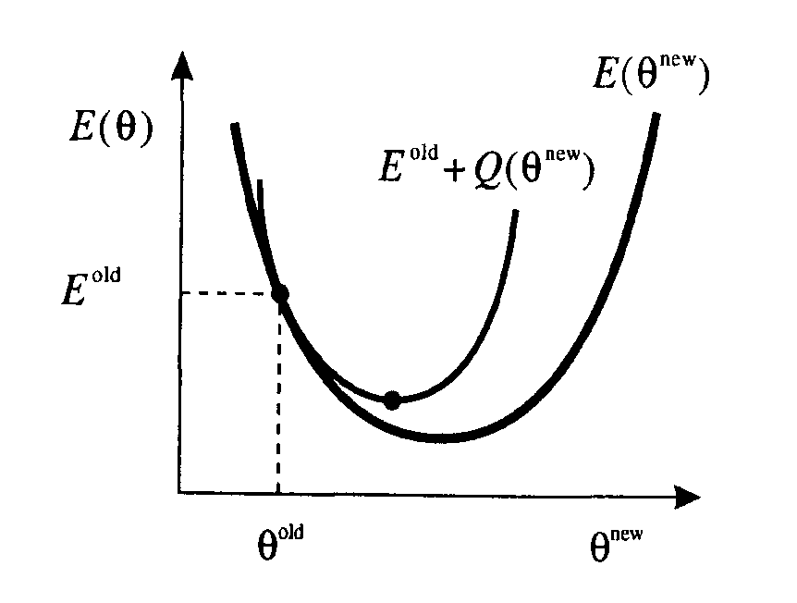
The EM algorithm
Consider P^{old}(j|x) as λj, then the changes of E gives
Let Q = , then , and is an upper bound of E^{new}.
As shown in figure, minimizing Q will lead to a decrease of E^{new}, unless E^{new} is already at a local minimum.
Schematic plot of the error function E as a function of the new value θ^{new} of one of the parameters of the mixture model. The curve E^{old} + Q(θ^{new}) provides an upper bound on the value of E (θ^{new}) and the EM algorithm involves finding the minimum value of this upper bound.
236875 Visual Recognition

Slide 39
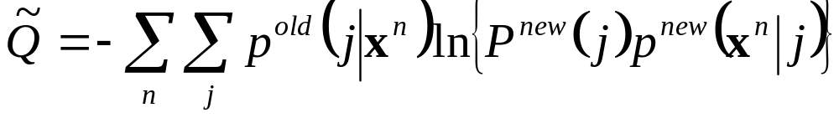

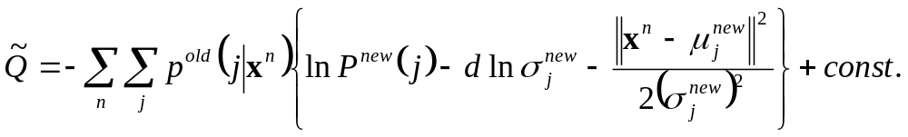
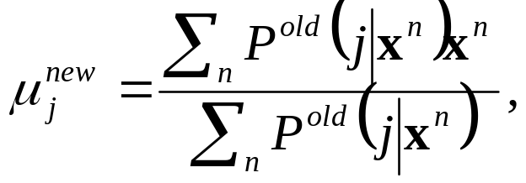
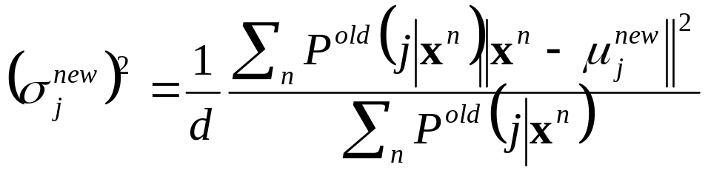
The EM algorithm
Let’s drop terms in Q that depends on only old parameters, and rewrite Q as
the smallest value for the upper bound is found by minimizing this quantity
for the Gaussian mixture model, the quality can be
we can now minimize this function with respect to ‘new’ parameters, and they are:
236875 Visual Recognition

Slide 40
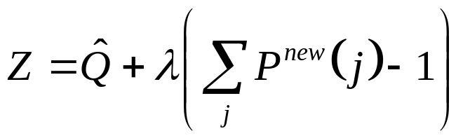
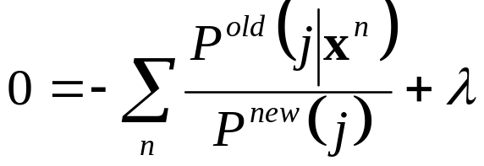
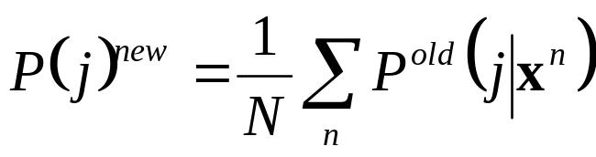
The EM algorithm
For the mixing parameters P^{new} (j), the constraint Σ_{j}P^{new} (j)=1 can be considered by using the Lagrange multiplier λ and
minimizing the combined function
Setting the derivative of Z with respect to P^{new} (j) to zero,
using Σ_{j}P^{new} (j)=1 and Σ_{j}P^{old} (j|x^{n})=1, we obtain λ = N, thus
Since the Σ_{j}P^{old} (j|x^{n}) term is on the right side, thus this results are ready for iteration computation
Exercise 2: shown on the nets
236875 Visual Recognition

